Slide 1
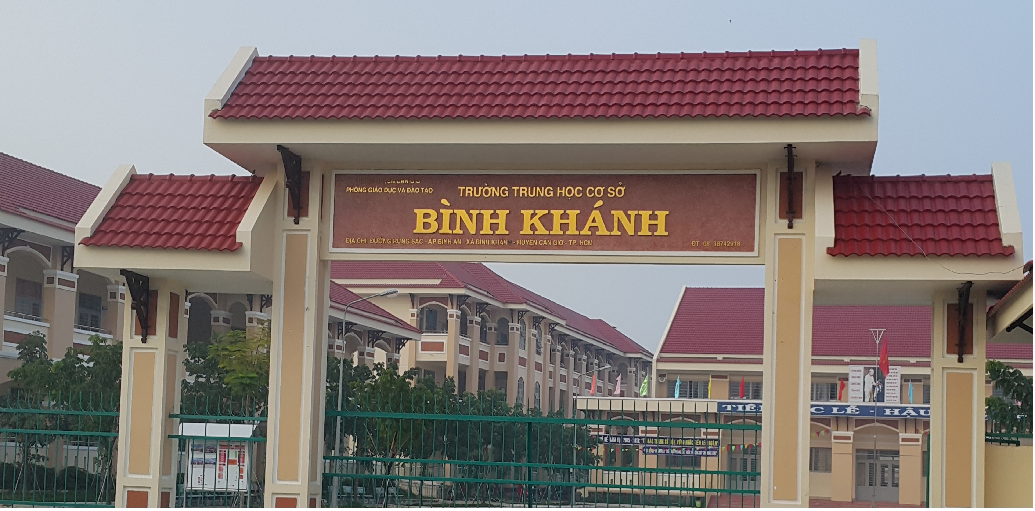
ENGLISH 9
BINH KHANH SECONDARY SCHOOL

Slide 2
Unit 6: THE ENVIRONMENT
<LANGUAGE FOCUS>

Slide 3
1. Adjectives and adverbs
Form :
Adjective + ly → Adverb
slow →
slowly
busy →
busily
Except :
well
good →
The same form : fast, hard, early, late…

Slide 4
Unit 6 - The environment
1. Language focus 1: Adjectives and adverbs
Example:
- My Tam is a beautiful singer. She sings beautifully
- They drive carefully. They are careful drivers
- S + be + a/an + adj + N
- S+ v + ADV

Slide 5
Exercise 1: Change the adjectives into adverbs.
Then use the adverbs to complete the sentences.
Adjective | Adverb
extreme
good
happy
sad
slow
extremely
well
happily
sadly
slowly

Slide 6
extremely
well
happily
sadly
slowly
a) Hoa was ______________ pleased that she got
an A for her assignment.
b) The old man walked ___________ to the park.
c) Tuan sighed ___________ when he heard that
he failed the test.
d) The baby laughed ___________ as she played
with her toys.
e) Mrs. Nga speaks English quite ___________ .

Slide 7
Unit 6 - The environment
1. Language focus 1: Adjectives and adverbs
2. Language focus 2:
Adverb clauses of reason
Because
= since
= as
Example:
- He failed the exam. He is too lazy
→ Reason
→ He failed the exam
because/ since/ as
he is too lazy
Adverb clause of reason
- Lan is late for school. She misses the bus
→ Reason
→ Lan is late for school
because/ since/ as
she misses the bus
Adverb clause of reason

Slide 8
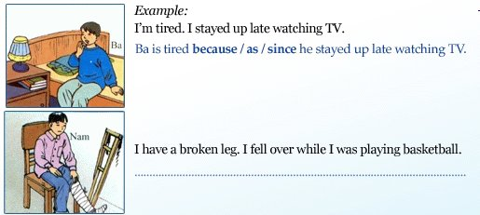
2. Join the pairs of sentences together. Use because, as, or since.
a)
b)
b) Nam has had a broken leg because he fell
over while he was playing soccer.

Slide 9
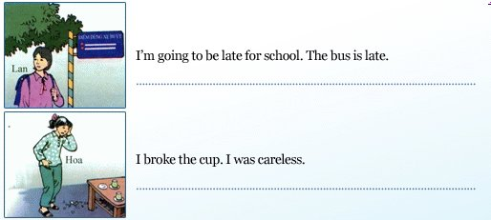
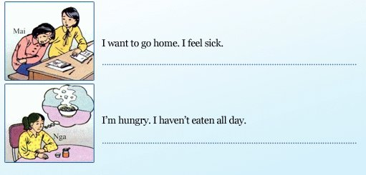

c)
Click on c), d), e), f) to get key
c) Lan’s going to be late for school because/since/ as the bus is late.
d)
d) Hoa broke the cup because/ since/ as she was careless.
e)
e) Mai wants to go home because/ since/ as she feels sick.
f)
f) Nga is hungry because/ since/ as she hasn’t eaten all day.

Slide 10

HOMEWORK
Do the exercises in your workbook at home.
Prepare next lesson

